Slide 1
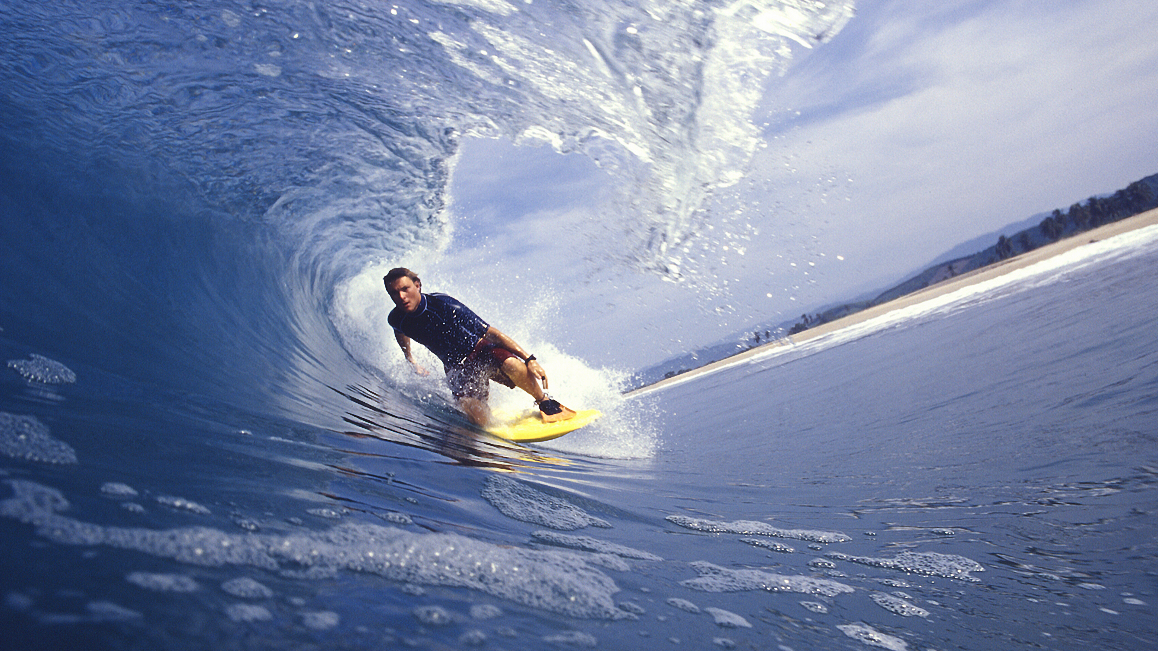
A Different Outcome
Romans 8:28-30
Notes:
Xians = Surfer Dudes → Cruising SAFELY inside the EYE of a TSUNAMI wave
=Disaster Pending all around, within INCHES, arm’s reach.
Yet: everything WILL be OK → IF we ~LOOSE FOCUS

Slide 2

An Anchor for a Lifetime
Anchor For:
Romans 8
The Bible
Everyday Life
Hebrews 6:19 This hope we have as an anchor of the soul, a hope both sure and steadfast
Romans 8:28 And we know that God causes all things to work together for good to those who love God, to those who are called according to His purpose.
Notes:
Ro.8:28 = LIFETIME Anchor
Read → Most FAMOUS → 1^2 Syllables → 4 Children!
**Anchor 4: Ro.8 =Underst. Implic: “New Identity”
** Bible=G’s Rsn 4 His Love Letter 2 Us
** He.6:19 “Hope” = Consist/FIRM: JC=a ROCK
** Everyday: “Rain falls…Just/Unjust” → Xians=Lifeboat

Slide 3
A Bitter Poison:
In Modern Christianity
“I Already Know That”
Hideously Misquoted!
my parents know
Romans 8:28 And we know that God causes all things to work together for good to those who love God, to those who are called according to His purpose.
some things
CENSORED
Notes:
Poisonous → BITTER / Dropout Xians → 20-30 Million
** MODERN Xians = Tragic: Holding G. 2 Promises ~Made
Xian Kids=Believe w/ Same Fervrence as **Parents/GrandP
w/o Same Knowledge of WOG = Crash/Burn Xians
**“I Know…” (i.e., “~Mk. Diff!”) ** “Some..” → ~NOW!!
=Symptom of OCD: @HC/CG/CT → DISBELIEF/Calloused
AP: Maybe ~ “Heard B4”? B4=Snotty Brat/Salty/Selfish?
** Misquoted → Esp. 4 BITTER Dropouts → **70% Censored
=Hideous God: “Part of God’s PLAN!” **BUCK Movie

Slide 4
“And we know…”
NOT:
“We feel…”
“My truth…”
It IS:
For we walk by TRUST, not by sight — 2 Cor. 5:7
Basic Maturity 101
Taking the Long View
Notes:
“KNOW” = Modern Childish Problem
**NOT: “Feel” / “Think” / “MY Truth” = Absolute
= Basis 4 Manipulat: Feelings, ~FACTS
KSU Prof: “Ur Goal=2 B Happy”
**It IS: 2Co.5=Walk ^ Fall → G’s WILL: Faith=FACTS
Maturity: Req. 4 WAR/JOB/EDUCAT/Marriage
Long View: KIDS=Over-React/Immediat

Slide 5
“And we know…”
What We Don’t Know:
Romans 8:26 The Spirit also helps our weakness; for we do not know how to pray as we should, but the Spirit Himself intercedes for us with groanings too deep for words;
Notes:
Ro.8:26=Delib. Contrast w/ 8:28
~KNOW How ^ WHAT 2 Pray 4 → ~See Spiritual Realm
**HS. Intercedes: “Groanings” = DEEP Sighs / Insights
RARE: =Illuminates → REDIRECTS → DEEPENS
IL: “End my Depress…” → “End my Alienated Relat”
AP: ~Underst. “Evil”? → PRAY=Insight/Redirection
OR: WHY G. ~Explain = UNECESS → IL: JOB
“Why ME?” = Infantile Cry → “Others yes, ~ME!”
AP: Always Explain= ~TRUST! =Distraction

Slide 6
“…God causes all things…”
A Terrible Distortion!
An Accusation, Assuming a Cruel God
Super-Spiritual Christians
“Rain falls on the just and unjust” means: accidents, other people, natural law, spiritual enemies…
Matthew 5:44-45 "But I say to you, love your enemies and pray for those who persecute you, so that you may be sons of your Father who is in heaven; for He causes His sun to rise on the evil and the good, and sends rain on the righteous and the unrighteous.”
Notes:
“Distortion” = OUT OF CONTEXT!
** Accusation: Cruel G=We R Puppets/Toys
WE KNOW: Human Life=HI VALUE
WOG=PROOF: G. Values Humans
**Super-Spirituals: “Car Accident” = “G. Did It”
**”Rain Falls…” → Xians ~Live in a BUBBLE!
** Mt.5 = G. Tolerates → So We Should → FREE Will Age
~Ovr Till It’s Over→ We ~Underst./ ~See Future

Slide 7
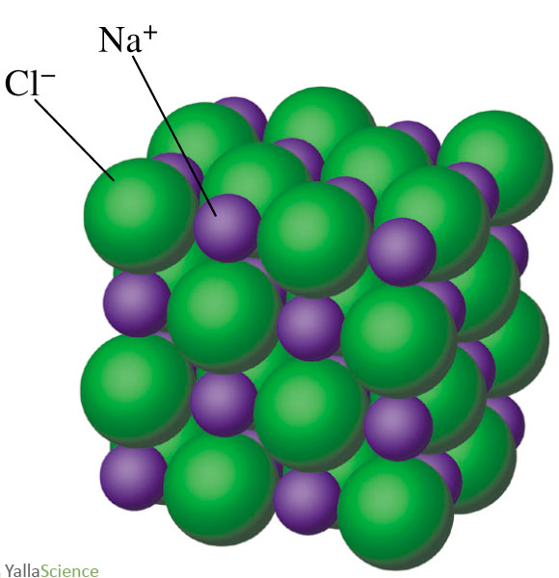
“…God causes all things to work together for good…”
Synergy Matters
συνεργέω “energizing together” present tragedy and future results
“The whole is greater than the sum of its parts”
Notes:
“Synergy” = **Sunergeo = ** =Aristotle:“Whole..Greater”
** IL: NaCl=POISONOUS PARTS!
** God = the CHEMIST
AP: Xian Suicide = Greatest Tragedy (Folly?)
~See the Chemistry of Life → ~CHEMIST?

Slide 8
“…good to those who love God…”
“Christian” means “God-Lover”
Romans 8:1 Therefore there is now no condemnation for those who are in Christ Jesus.
“Trusting God” IS Loving God
Notes:
“Xian” = “God-Lover” → GOSP: U=Want Relat. w/G?
= #1 Issue: ~Else Matters→ ~Events/Tragedies/~RULES!
**Ro. 8:1 “In Christ” = Christ IN U
GOSP: TONIGHT=NEW OUTCOME/RESULTS/PROMISES
AP: Xians→ TRUST=PERSONAL=LOVING G.
~ “Trust…FORCE” / Bank / Payday (=UTILITARIAN)
IS: “I TRUST my SPOUSE” (bc I Luv Her & She-Me)

Slide 9
“…those who love God AND are called according to His purpose”
God’s Purpose for Humankind
2 Corinthians 6:16 …For we are the temple of the living God; just as God said, “I will dwell in them and walk among them.”
ALSO: Ex 29:45-46; Nu 5:3; Dt 12:11; 1Ki 6:13; Rev 21:3
“Loving God” Means a Whole New Calling
Life With PURPOSE
Not a chaotic jumble of events.
Notes:
“Called” = **PURP, ~Chaos
**G’s Purp=AMAZING! “Dwell” =HS/ “Walk”=JC
Spans OT/NT→ MOSES / Prophets / David / All NT

Slide 10
…God causes all things to work together for good to those who love God, to those who are called…”
“Loving God” Means Different Results:
A Victorious Outcome
Astonishing Decay
Isaiah 40:30-31 Though youths grow weary and tired, And vigorous young men stumble badly, Yet those who wait for the LORD Will gain new strength; They will mount up with wings like eagles…
Ezekiel 28:19 “All who know you among the peoples are appalled at you; You have become terrified…”
Proverbs 28:1 The wicked flee when no one is pursuing, But the righteous are bold as a lion.
Notes:
** Victorious: ~Can Happen 2 U w/o Vict. Outcome
=Grwth: STATURE/Wisdm/POWER, esp. COURAGE
= **Is. 40→ AP: u=DEPRESSED=OK → ~Last Long
**^ Decay=Confusion / Cowardice / Useless
**Ez.28=Satan → But SOME Xians=Fall PREY
“Terrified” = **Pr.28:1 → Paranoid/Weak/Cowardly
AP: Spiritual Dimension 2 Life→ Convert=MIRAC.Changes
Hard Hearts=MIRAC. Decay!

Slide 11
How Does God “Work all things together for good”?
Romans 8:29-30 For those whom He foreknew, He also predestined to become conformed to the image of His Son, so that He would be the firstborn among many brethren; and these whom He predestined, He also called; and these whom He called, He also justified; and these whom He justified, He also glorified.
Notes:
ALL THIS = God’s WORK/ Assurance

Slide 12
How Does God “Work all things together for good”?
Romans 8:29-30 For those whom He foreknew, He also predestined to become conformed to the image of His Son, so that He would be the firstborn among many brethren; and these whom He predestined, He also called; and these whom He called, He also justified; and these whom He justified, He also glorified.
Known Before Creation
Predestined, Prepared
Called by God
Justified: Valued, Endeared
Glorified: Transformed
Notes:
“Foreknew” = “WHOM”
= PERSONAL: Knew U & Choices / Handicaps / Rebellion
“B4 Foundation…Earth” → UR Surprised, ~G!!

Slide 13
How Does God “Work all things together for good”?
Romans 8:29-30 For those whom He foreknew, He also predestined to become conformed to the image of His Son, so that He would be the firstborn among many brethren; and these whom He predestined, He also called; and these whom He called, He also justified; and these whom He justified, He also glorified.
Known Before Creation
Predestined, Prepared
Called by God
Justified: Valued, Endeared
Glorified: Transformed
NOT
Notes:
“Predest” != 2 HELL → Only Believers → i.e., Gud Outcome
“Conformed” = VICTORIOUS= JC → =Character Change
“First…Many” = “WALK AMONG THEM” → =GROWNUPS!
Predestined = PREPARED → G. Knows Ur Choices/ Personality
Ur Gifts / Likes / Dislikes → Will LEAD U In2 VICTORY
AP: “Happy” ~ #1 Goal → Maturity/Victory = OUCH!
AP: ** g ~Force Me 2 Become a Missionary in Borneo

Slide 14
How Does God “Work all things together for good”?
Romans 8:29-30 For those whom He foreknew, He also predestined to become conformed to the image of His Son, so that He would be the firstborn among many brethren; and these whom He predestined, He also called; and these whom He called, He also justified; and these whom He justified, He also glorified.
Known Before Creation
Predestined, Prepared
Called by God
Justified: Valued, Endeared
Glorified: Transformed
Notes:
“Called” = Called 2Gether → 4 Winds → Mirac. Story
IL: Dar Prep. 4 Me→ Ontario → Michigan → OSU → Fundies
All Along: “She’s STILL … Princess…4 a DOG…”
=Req. MORE WORK! Poor Darlene! → Lucky ME!!

Slide 15
How Does God “Work all things together for good”?
Romans 8:29-30 For those whom He foreknew, He also predestined to become conformed to the image of His Son, so that He would be the firstborn among many brethren; and these whom He predestined, He also called; and these whom He called, He also justified; and these whom He justified, He also glorified.
Known Before Creation
Predestined, Prepared
Called by God
Justified: Died to the Law
Glorified: Transformed
Notes:
Justif=Given VALUE / Acepted / Endeared = “Died 2 LAW”
Law=Req. 4 EVIL World→ IL: Police/War/REVENGE=Necess.
Xians= “New Way/Outcome” → By GRACE=Why Ppl Reject It
?? Possib? Ro.8:28!! → G @Work!!
AP: “~Fair! Why ME!?” = Illegitim!! Grace= ~Appeal 2 “Fair”
G=Can Use UNFAIR 2 Chng Me \ LEGALISTS=Disillusioned!
AP: Mad @G=DUMB→ Cuts off Opport. 4 Gud→ ~Elim.Evil!
As Bad as It Gets, It Can ALWAYS Get Worse!

Slide 16
How Does God “Work all things together for good”?
Romans 8:29-30 For those whom He foreknew, He also predestined to become conformed to the image of His Son, so that He would be the firstborn among many brethren; and these whom He predestined, He also called; and these whom He called, He also justified; and these whom He justified, He also glorified.
Known Before Creation
Predestined, Prepared
Called by God
Justified: Valued, Endeared
Glorified: Transformed
Romans 8:19 For the anxious longing of the creation waits eagerly for the revealing of the sons of God.
Notes:
“Glorified” = SATURATED w/ SIGNIF!
Ro. 8:19 = Universal Glory→ All Creation Affected
AP: Remember THAT Next Time Ur Whining!

Slide 17
How Does God “Work all things together for good”?
Acts 3:8 With a leap he stood upright and began to walk; and he entered the temple with them, walking and leaping and praising God.
Known Before Creation
Predestined, Prepared
Called by God
Justified: Valued, Endeared
Glorified: Transformed
Rom. 8:28 explains James 1:2…
“Consider it all joy, my brethren, when you encounter various trials”
Notes:
“Glorified” = HERE & NOW 2! →
IL: **Acts 3:8 = Best Descript of GLORIFIED
** =Jas. 1:2 → KNOWING G=GLORIFYING U

Slide 18
“And we know…”
Romans 8:28 is the cure for Thankful Dementia!
1 Peter 2:3 if you have tasted the kindness of the Lord.
Best Cure: “walking and leaping and praising God.” Acts 3:8
1 Peter 2:12 Keep your behavior excellent among the Pagans, so…as they observe, glorify God in the day of visitation.
Notes:
Hello! Older Xians! → ?? Do U Know?? **Ro.8:28=CURE
THANKFUL DEMENTIA=Short Term Mem.Loss
~Limited 2 MY Age! → Baked In2 R Brains!
=TREMENDOUS Ability 2 Distort G’s RECORD: Kindness
IL: Last Mo=Walking/Leaping → This Mo.=WHINING/POUTING
Last Mo= “I Luv BOC” → This= “Nobody CARES!”
**THUS: 1Pe.2:3= Tongue-In-Cheek → AP: JOURNAL
BETTER: **Acts 3:8 = LIVING Thankfulness!!
= **1Pe.= G’s Rsn. 4 Letting U Suffer→CONTAGIOUS JOY

